Slide 1
Data Understanding

Slide 2
Data, Measurements, and Data Preprocessing
Data Types
Statics of Data
Similarity and Distance Measures
Data Quality, Data Cleaning and Data Integration
Data Transformation
Dimensionality Reduction
Summary

Slide 3
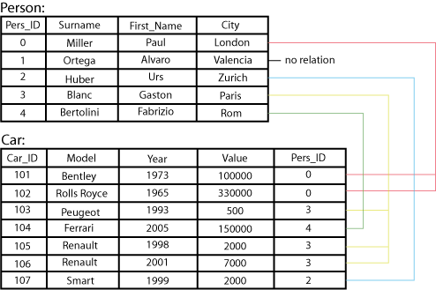
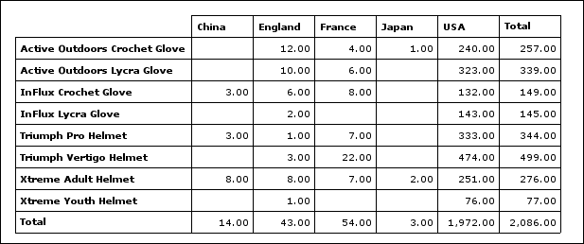
Types of Data Sets: (1) Record Data
Relational records
  Relational tables, highly structured
Data matrix, e.g., numerical matrix, crosstabs
Transaction data
Document data: Term-frequency vector (matrix) of text documents

Slide 4


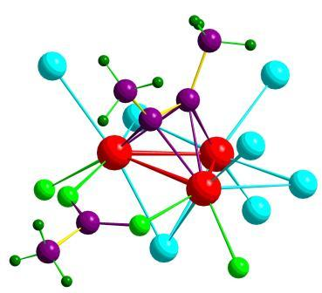

Types of Data Sets: (2) Graphs and Networks
Transportation network
World Wide Web
Molecular Structures
Social or information networks

Slide 5

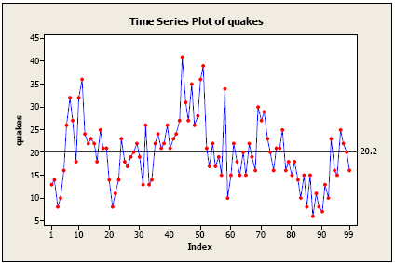
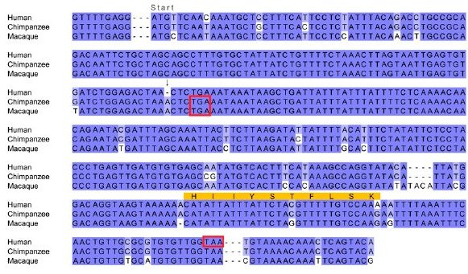
Types of Data Sets: (3) Ordered Data
Video data: sequence of images
Temporal data: time-series
Sequential Data: transaction sequences
Genetic sequence data

Slide 6
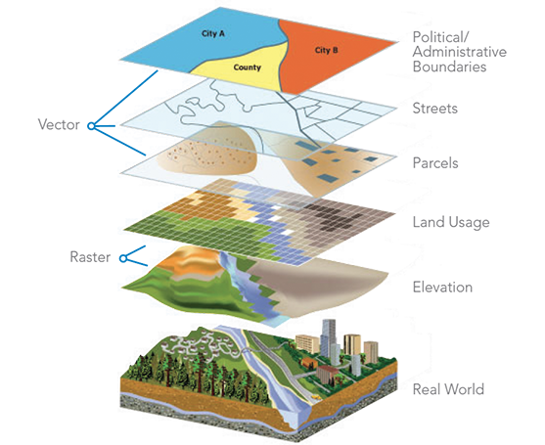

Types of Data Sets: (4) Spatial, image and multimedia Data
Spatial data: maps
Image data:
Video data:

Slide 7
Important Characteristics of Structured Data
Dimensionality
  Curse of dimensionality
Sparsity
  Only presence counts
Resolution
  Patterns depend on the scale
Distribution
  Centrality and dispersion

Slide 8
Data Objects
Data sets are made up of data objects
A data object represents an entity
Examples:
  sales database: customers, store items, sales
  medical database: patients, treatments
  university database: students, professors, courses
Also called samples , examples, instances, data points, objects, tuples
Data objects are described by attributes
Database rows → data objects; columns → attributes

Slide 9
Attributes
Attribute (or dimensions, features, variables)
  A data field, representing a characteristic or feature of a data object.
  E.g., customer _ID, name, address
Types:
  Nominal (e.g., red, blue)
  Binary (e.g., {true, false})
  Ordinal (e.g., {freshman, sophomore, junior, senior})
  Numeric: quantitative
    Interval-scaled: 100○C is interval scales
    Ratio-scaled: 100○K is ratio scaled since it is twice as high as 50 ○K
  Discrete vs. Continuous Attributes

Slide 10
Attribute Types
Nominal: categories, states, or “names of things”
  Hair_color = {auburn, black, blond, brown, grey, red, white}
  marital status, occupation, ID numbers, zip codes
Binary
  Nominal attribute with only 2 states (0 and 1)
  Symmetric binary: both outcomes equally important
    e.g., gender
  Asymmetric binary: outcomes not equally important.
    e.g., medical test (positive vs. negative)
    Convention: assign 1 to most important outcome (e.g., HIV positive)
Ordinal
  Values have a meaningful order (ranking) but magnitude between successive values is not known
  Size = {small, medium, large}, grades, army rankings

Slide 11
Numeric Attribute Types
Quantity (integer or real-valued)
Interval
    Measured on a scale of equal-sized units
    Values have order
      E.g., temperature in C˚or F˚, calendar dates
    No true zero-point
Ratio
    Inherent zero-point
    We can speak of values as being an order of magnitude larger than the unit of measurement (10 K˚ is twice as high as 5 K˚).
      e.g., temperature in Kelvin, length, counts, monetary quantities

Slide 12
Discrete vs. Continuous Attributes
Discrete Attribute
  Has only a finite or countably infinite set of values
    E.g., zip codes, profession, or the set of words in a collection of documents
  Sometimes, represented as integer variables
  Note: Binary attributes are a special case of discrete attributes
Continuous Attribute
  Has real numbers as attribute values
    E.g., temperature, height, or weight
  Practically, real values can only be measured and represented using a finite number of digits
  Continuous attributes are typically represented as floating-point variables

Slide 13
Statics of Data
Measuring the Central Tendency
Measuring the Dispersion of Data
Covariance and Correlation Analysis
Graphic Displays of Basic Statics of Data

Slide 14
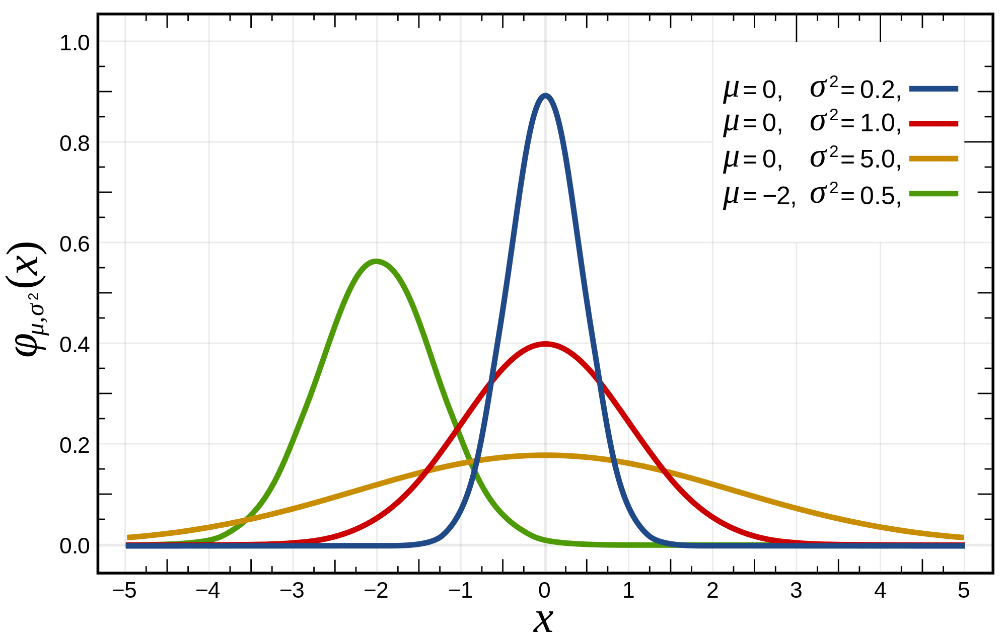
Basic Statistical Descriptions of Data
Motivation
  To better understand the data: central tendency, variation and spread
Data dispersion characteristics
  Median, max, min, quantiles, outliers, variance, ...
Numerical dimensions correspond to sorted intervals
  Data dispersion:
    Analyzed with multiple granularities of precision
  Boxplot or quantile analysis on sorted intervals
Dispersion analysis on computed measures
  Folding measures into numerical dimensions
  Boxplot or quantile analysis on the transformed cube
Notes:
Note to self (MK): last part of slide does not clearly match slides that follow
Introduction slides:
In the current version, we only talk about numeric data. Can we add some materials about non-numeric data.
- text statistics, TF/IDF
- visualization of text statistics such as word cloud
- distribution of Internet (IN, SCC, OUT, …)
- visualization of social relationship (e.g., http://renlifang.msra.cn/)

Slide 15
Measuring the Central Tendency: (1) Mean
Mean (algebraic measure) (sample vs. population):
  Note: n is sample size and N is population size.
Weighted arithmetic mean:
Trimmed mean:
  Chopping extreme values (e.g., Olympics gymnastics score computation)

Slide 16
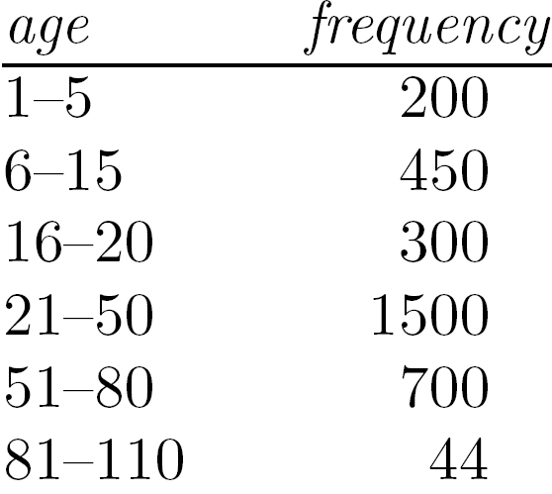
Measuring the Central Tendency: (2) Median
Median:
  Middle value if odd number of values, or average of the middle two values otherwise
Estimated by interpolation (for grouped data):
Approximate median
Sum before the median interval
Interval width (L₂ – L₁)
Low interval limit

Slide 17
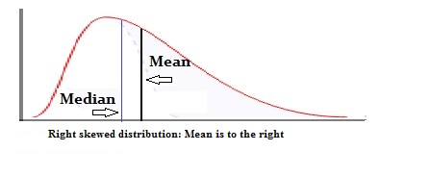
Measuring the Central Tendency: (3) Mode
Mode: Value that occurs most frequently in the data
Unimodal
  Empirical formula:

Slide 18
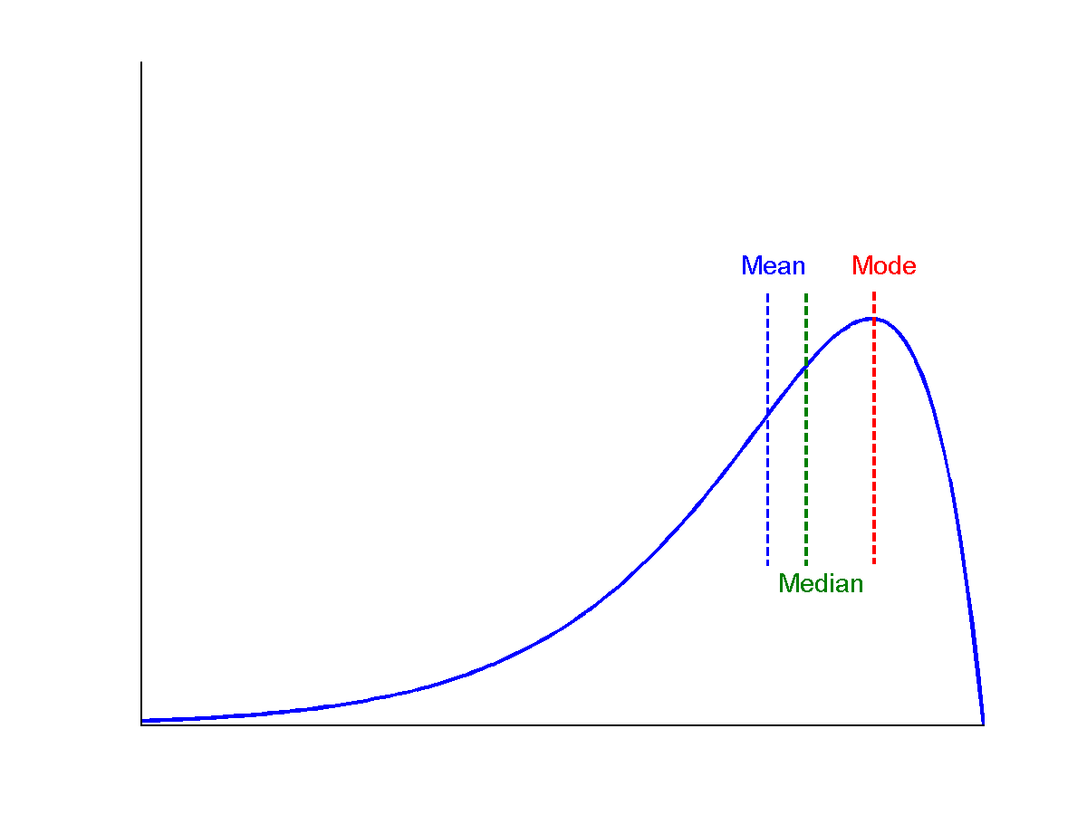
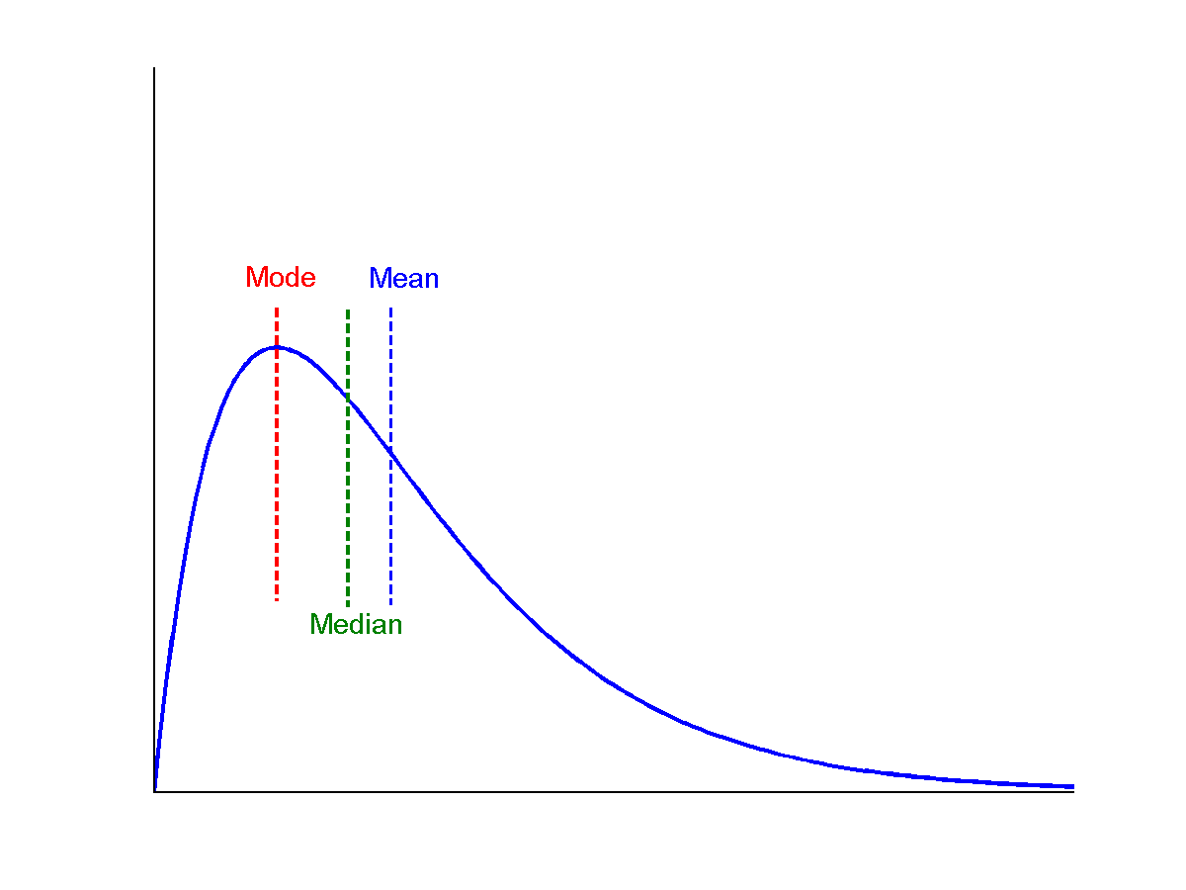
Symmetric vs. Skewed Data
symmetric
Median, mean and mode of symmetric, positively and negatively skewed data
positively skewed
negatively skewed

Slide 19
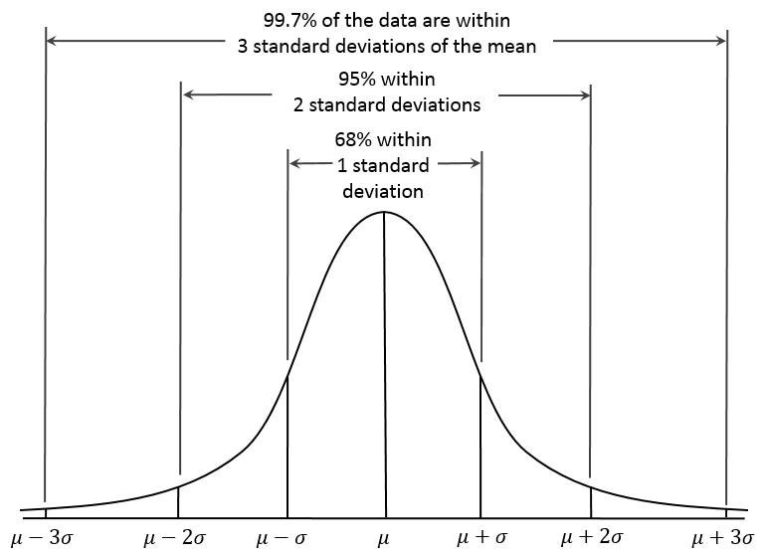
Properties of Normal Distribution Curve
← — ————Represent data dispersion, spread — ————→
Represent central tendency

Slide 20
Measures Data Distribution: Variance and Standard Deviation
Variance and standard deviation (sample: s, population: σ)
  Variance: (algebraic, scalable computation)
      Q: Can you compute it incrementally and efficiently?
  Standard deviation s (or σ) is the square root of variance s² ⁽or σ²⁾
Note: The subtle difference of formulae for sample vs. population
n : the size of the sample
N : the size of the population

Slide 21

Variance for Single Variable (Numerical Data)
The variance of a random variable X provides a measure of how much the value of X deviates from the mean or expected value of X:
  where σ² is the variance of X, σ is called standard deviation
        µ is the mean, and µ = E[X] is the expected value of X
  That is, variance is the expected value of the square deviation from the mean
  It can also be written as:
Sample variance
$$s^{2}=\frac{1}{n}\sum_{i}^{n}{{\left(x_{i}−\hat{μ}\right)}^{2}} s^{2}=\frac{1}{n−1}\sum_{i}^{n}{{\left(x_{i}−\hat{μ}\right)}^{2}}$$

Slide 22
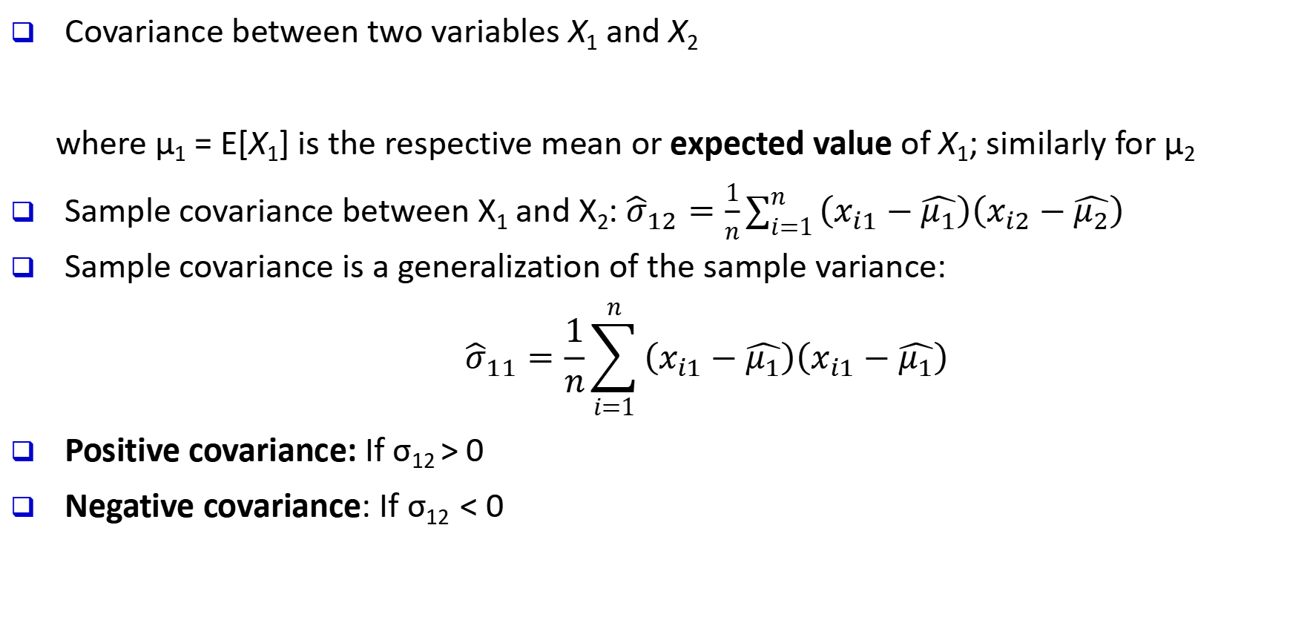
Covariance for Two Variables
Covariance between two variables X₁ and X₂
    where µ₁ = E[X₁] is the respective mean or expected value of X₁; similarly for µ₂
Sample covariance between X₁ and X₂: ${\hat{σ}}_{12}=\frac{1}{n}\sum_{i=1}^{n}{\left(x_{i1}−\hat{μ_{1}}\right)\left(x_{i2}−\hat{μ_{2}}\right)}$
Sample covariance is a generalization of the sample variance:
$${\hat{σ}}_{11}=\frac{1}{n}\sum_{i=1}^{n}{\left(x_{i1}−\hat{μ_{1}}\right)\left(x_{i1}−\hat{μ_{1}}\right)}$$
Positive covariance: If σ₁₂ > 0
Negative covariance: If σ₁₂ < 0

Slide 23
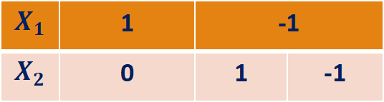
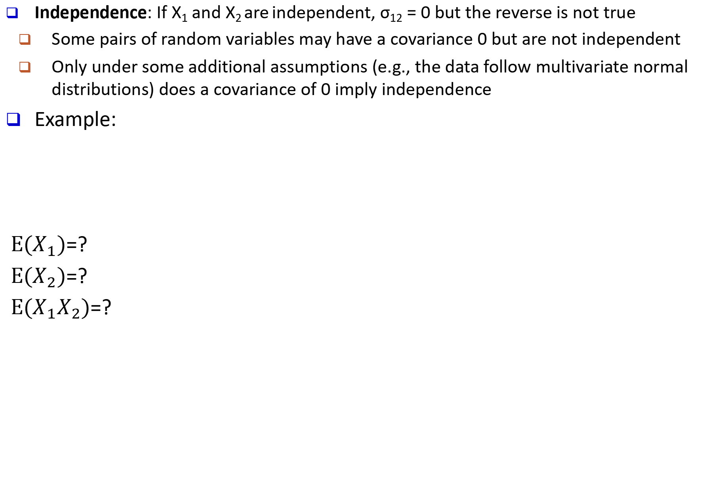
Covariance for Two Variables
Independence: If X₁ and X₂ are independent, σ₁₂ = 0 but the reverse is not true
  Some pairs of random variables may have a covariance 0 but are not independent
  Only under some additional assumptions (e.g., the data follow multivariate normal distributions) does a covariance of 0 imply independence
Example:
$E(X_{1})$=?
$E(X_{2})$=?
$E(X_{1}X_{2})$=?
$$X_{1}$$ | 1 | -1
$$X_{2}$$ | 0 | 1 | -1

Slide 24
Example: Calculation of Covariance
Suppose two stocks X₁ and X₂ have the following values in one week:
    (2, 5), (3, 8), (5, 10), (4, 11), (6, 14)
Question: If the stocks are affected by the same industry trends, will their prices rise or fall together?
Covariance formula
Its computation can be simplified as:
  E(X₁) = (2 + 3 + 5 + 4 + 6)/ 5 = 20/5 = 4
  E(X₂) = (5 + 8 + 10 + 11 + 14) /5 = 48/5 = 9.6
  σ₁₂ = (2×5 + 3×8 + 5×10 + 4×11 + 6×14)/5 − 4 × 9.6 = 4
Thus, X₁ and X₂ rise together since σ₁₂ > 0

Slide 25
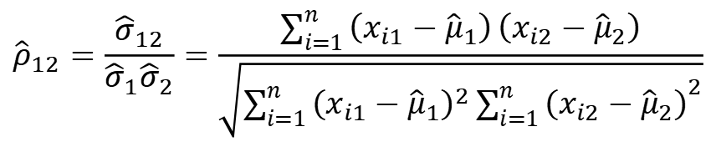
Correlation between Two Numerical Variables
  Correlation between two variables X₁ and X₂ is the standard covariance, obtained by normalizing the covariance with the standard deviation of each variable
Sample correlation for two attributes X₁ and X₂:
      where n is the number of tuples, µ₁ and µ₂ are the respective means of X₁ and X₂ , σ₁ and σ₂ are the respective standard deviation of X₁ and X₂
If ρ₁₂ > 0: A and B are positively correlated (X₁’s values increase as X₂’s)
  The higher, the stronger correlation
If ρ₁₂ = 0: independent (under the same assumption as discussed in co-variance)
If ρ₁₂ < 0: negatively correlated
$${\hat{ρ}}_{12}=\frac{{\hat{σ}}_{12}}{{\hat{σ}}_{1}{\hat{σ}}_{2}}=\frac{\sum_{i=1}^{n}{\left(x_{i1}−{\hat{μ}}_{1}\right)}\left(x_{i2}−{\hat{μ}}_{2}\right)}{\sqrt{\sum_{i=1}^{n}{{\left(x_{i1}−{\hat{μ}}_{1}\right)}^{2}}{\sum_{i=1}^{n}{\left(x_{i2}−{\hat{μ}}_{2}\right)}}^{2}}}$$

Slide 26

Visualizing Changes of Correlation Coefficient
Correlation coefficient value range: [–1, 1]
A set of scatter plots shows sets of points and their correlation coefficients changing from –1 to 1

Slide 27
Covariance Matrix
The variance and covariance information for the two variables X₁ and X₂ can be summarized as 2 X 2 covariance matrix as
Generalizing it to d dimensions, we have,

Slide 28
Graphic Displays of Basic Statistical Descriptions
Boxplot: graphic display of five-number summary
Histogram: x-axis are values, y-axis repres. frequencies
Quantile plot: each value x_{i} is paired with f_{i} indicating that approximately 100 f_{i} % of data are ≤ x_{i}
Quantile-quantile (q-q) plot: graphs the quantiles of one univariant distribution against the corresponding quantiles of another
Scatter plot: each pair of values is a pair of coordinates and plotted as points in the plane
Notes:
JH: Maybe we can remove Loess curve

Slide 29
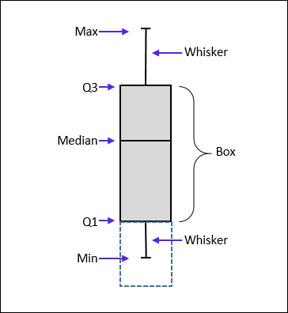
Measuring the Dispersion of Data: Quartiles & Boxplots
Quartiles: Q₁ (25th percentile), Q₃ (75th percentile)
Inter-quartile range: IQR = Q₃ – Q₁
Five number summary: min, Q₁, median, Q₃, max
Boxplot: Data is represented with a box
  Q₁, Q₃, IQR: The ends of the box are at the first and third quartiles, i.e., the height of the box is IQR
  Median (Q₂) is marked by a line within the box
  Whiskers: two lines outside the box extended to Minimum and Maximum
  Outliers: points beyond a specified outlier threshold, plotted individually
    Outlier: usually, a value higher/lower than 1.5 x IQR

Slide 30
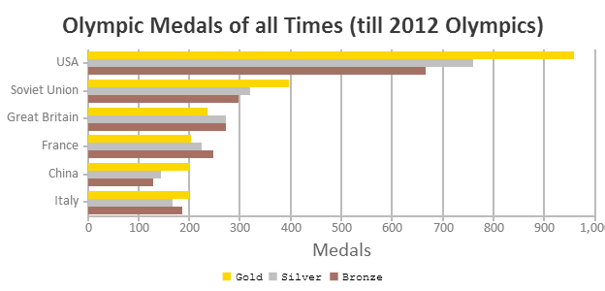
Histogram Analysis
Histogram
Histogram: Graph display of tabulated frequencies, shown as bars
Differences between histograms and bar charts
  Histograms are used to show distributions of variables while bar charts are used to compare variables
  Histograms plot binned quantitative data while bar charts plot categorical data
  Bars can be reordered in bar charts but not in histograms
  Differs from a bar chart in that it is the area of the bar that denotes the value, not the height as in bar charts, a crucial distinction when the categories are not of uniform width
Bar chart
Notes:
JH: A better and BASIC histogram figure --- because this one overlaps with a later one!

Slide 31
Histograms Often Tell More than Boxplots
The two histograms shown in the left may have the same boxplot representation
  The same values for: min, Q1, median, Q3, max
But they have rather different data distributions

Slide 32
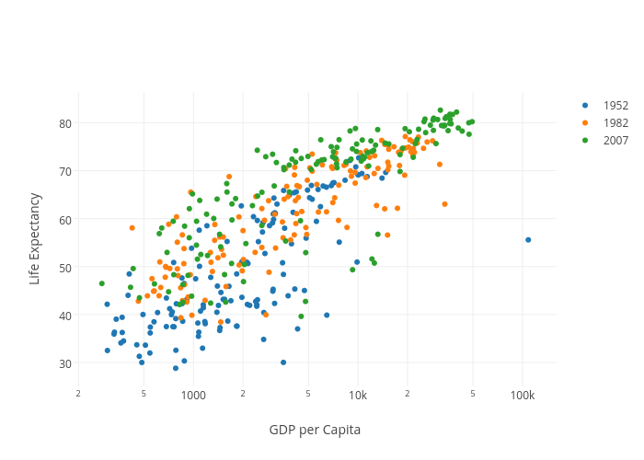
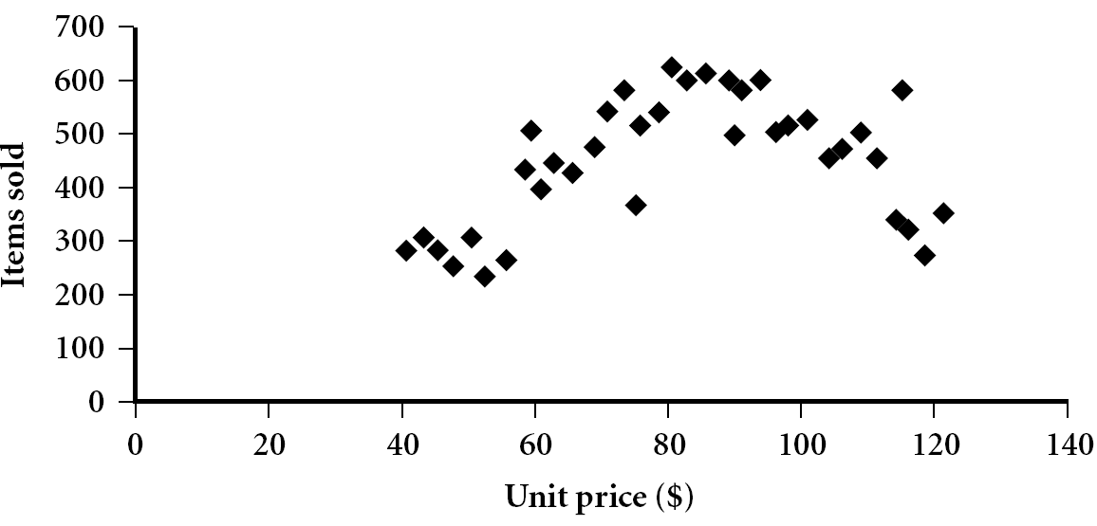
Scatter plot
Provides a first look at bivariate data to see clusters of points, outliers, etc.
Each pair of values is treated as a pair of coordinates and plotted as points in the plane
Notes:
Need a better and more MEANINGFUL scatter plot! -JH

Slide 33
Positively and Negatively Correlated Data
The left half fragment is positively correlated
The right half is negative correlated

Slide 34
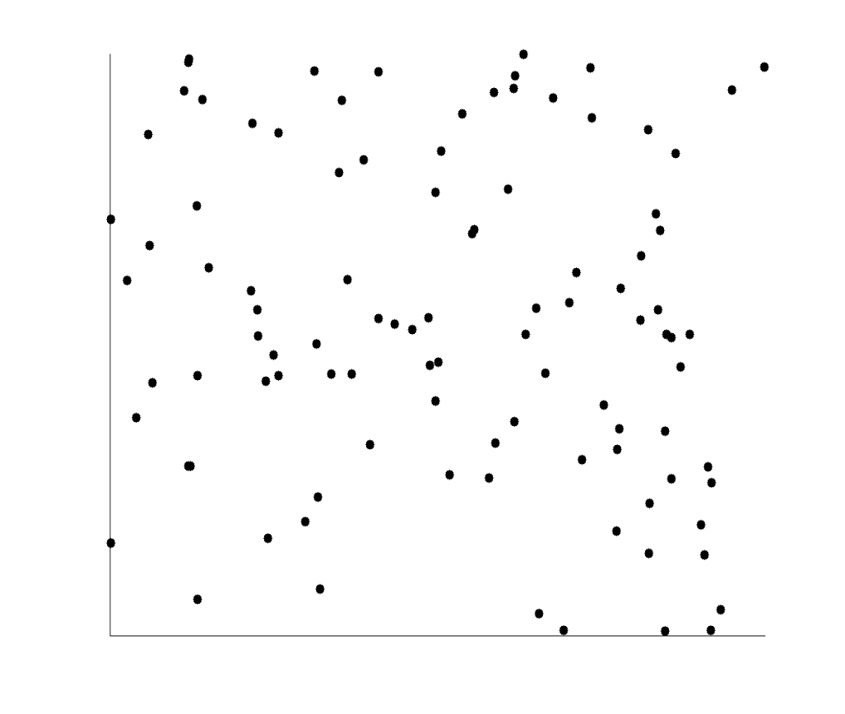
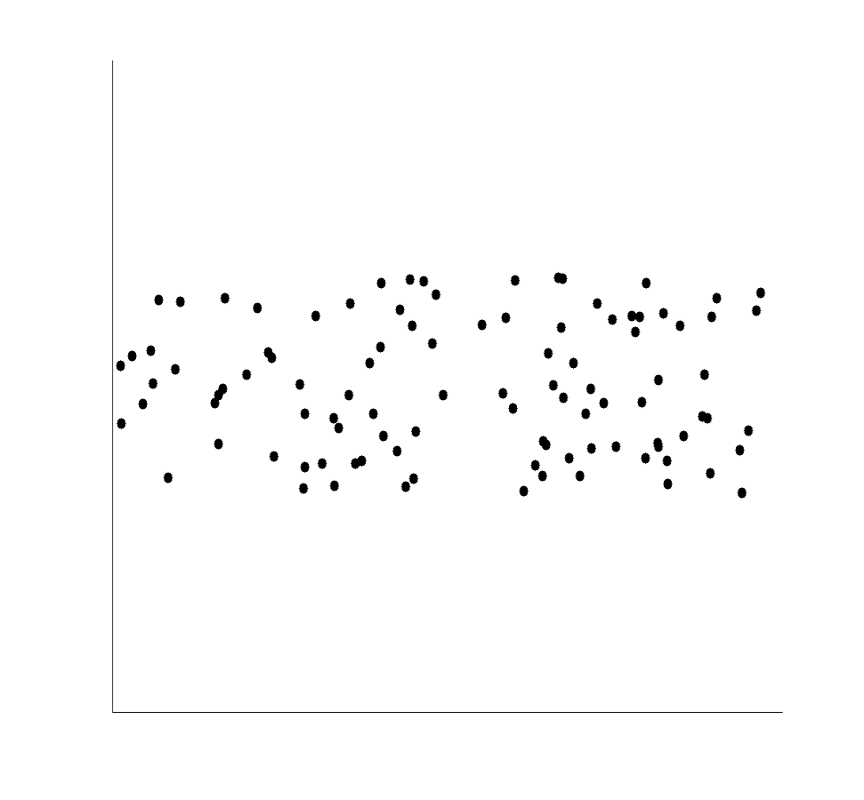
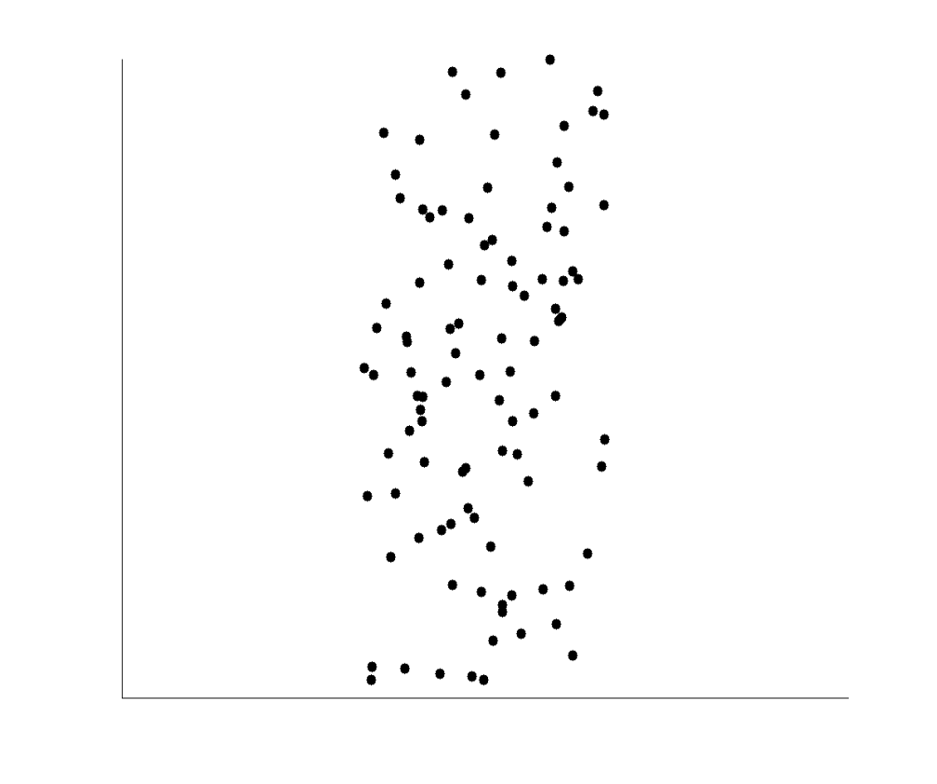
Uncorrelated Data

Slide 35
Similarity and Distance Measures
Data Matrix versus Dissimilarity Matrix
Proximity Measures for Nominal Attributes
Proximity Measures for Binary Attributes
Dissimilarity of Numeric Data: Minkowski Distance
Proximity Measures for Ordinal Attributes
Dissimilarity for Attributes of Mixed Types
Cosine Similarity
Measuring Similar Distributions: The Kullback-Leibler Divergence
Capturing Hidden Semantics in Similarity Measures

Slide 36
Similarity, Dissimilarity, and Proximity
Similarity measure or similarity function
  A real-valued function that quantifies the similarity between two objects
  Measure how two data objects are alike: The higher value, the more alike
  Often falls in the range [0,1]: 0: no similarity; 1: completely similar
Dissimilarity (or distance) measure
  Numerical measure of how different two data objects are
  In some sense, the inverse of similarity: The lower, the more alike
  Minimum dissimilarity is often 0 (i.e., completely similar)
  Range [0, 1] or [0, ∞) , depending on the definition
Proximity usually refers to either similarity or dissimilarity

Slide 37
Data Matrix and Dissimilarity Matrix
Data matrix
  A data matrix of n data points with l dimensions
Dissimilarity (distance) matrix
  n data points, but registers only the distance d(i, j) (typically metric)
  Usually symmetric, thus a triangular matrix
  Distance functions are usually different for real, boolean, categorical, ordinal, ratio, and vector variables
  Weights can be associated with different variables based on applications and data semantics

Slide 38
Standardizing Numeric Data
Z-score:
  X: raw score to be standardized, μ: mean of the population, σ: standard deviation
  the distance between the raw score and the population mean in units of the standard deviation
  negative when the raw score is below the mean, “+” when above
An alternative way: Calculate the mean absolute deviation
  where
  standardized measure (z-score):
Using mean absolute deviation is more robust than using standard deviation
Notes:
MK: For lecture, this may be OK here, but I think discussion of standardization/normalization is better kept all together in Chapter 3

Slide 39
Example: Data Matrix and Dissimilarity Matrix
Data Matrix
Dissimilarity Matrix (by Euclidean Distance)

Slide 40
Distance on Numeric Data: Minkowski Distance
Minkowski distance: A popular distance measure
  where i = (x_{i1}, x_{i2}, …, x_{il}) and j = (x_{j1}, x_{j2}, …, x_{jl}) are two l-dimensional data objects, and p is the order (the distance so defined is also called L-p norm)
Properties
  d(i, j) > 0 if i ≠ j, and d(i, i) = 0 (Positivity)
  d(i, j) = d(j, i) (Symmetry)
  d(i, j) ≤ d(i, k) + d(k, j) (Triangle Inequality)
A distance that satisfies these properties is a metric
Note: There are nonmetric dissimilarities, e.g., set differences

Slide 41
Special Cases of Minkowski Distance
p = 1: (L₁ norm) Manhattan (or city block) distance
  E.g., the Hamming distance: the number of bits that are different between two binary vectors
p = 2: (L₂ norm) Euclidean distance
p → ∞: (L_{max} norm, L∞ norm) “supremum” distance
  The maximum difference between any component (attribute) of the vectors

Slide 42
Example: Minkowski Distance at Special Cases
Manhattan (L₁)
Euclidean (L₂)
Supremum (L∞)

Slide 43
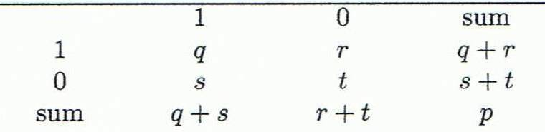
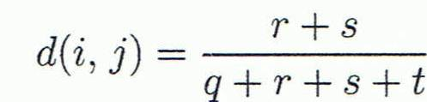
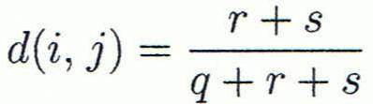

Proximity Measure for Binary Attributes
A contingency table for binary data
Distance measure for symmetric binary variables:
Distance measure for asymmetric binary variables:
Jaccard coefficient (similarity measure for asymmetric binary variables):
Note: Jaccard coefficient is the same as “coherence”:
Object j
Object i
(a concept discussed in Pattern Discovery)

Slide 44
Example: Dissimilarity between Asymmetric Binary Variables
Mary
 | 1 | 0 | ∑_{row}
1 | 2 | 0 | 2
0 | 1 | 3 | 4
∑_{col} | 3 | 3 | 6
Jack
Gender is a symmetric attribute (not counted in)
The remaining attributes are asymmetric binary
Let the values Y and P be 1, and the value N be 0
Distance:
Jim
 | 1 | 0 | ∑_{row}
1 | 1 | 1 | 2
0 | 1 | 3 | 4
∑_{col} | 2 | 4 | 6
Jack
Mary
 | 1 | 0 | ∑_{row}
1 | 1 | 1 | 2
0 | 2 | 2 | 4
∑_{col} | 3 | 3 | 6
Jim

Slide 45
Proximity Measure for Categorical Attributes
Categorical data, also called nominal attributes
  Example: Color (red, yellow, blue, green), profession, etc.
Method 1: Simple matching
  m: # of matches, p: total # of variables
Method 2: Use a large number of binary attributes
  Creating a new binary attribute for each of the M nominal states

Slide 46
Ordinal Variables
An ordinal variable can be discrete or continuous
Order is important, e.g., rank (e.g., freshman, sophomore, junior, senior)
Can be treated like interval-scaled
  Replace an ordinal variable value by its rank:
  Map the range of each variable onto [0, 1] by replacing i-th object in the f-th variable by
    Example: freshman: 0; sophomore: 1/3; junior: 2/3; senior 1
      Then distance: d(freshman, senior) = 1, d(junior, senior) = 1/3
  Compute the dissimilarity using methods for interval-scaled variables

Slide 47
Attributes of Mixed Type
A dataset may contain all attribute types
  Nominal, symmetric binary, asymmetric binary, numeric, and ordinal
One may use a weighted formula to combine their effects:
  If f is numeric: Use the normalized distance
  If f is binary or nominal: d_{ij}^{(f)} = 0 if x_{if} = x_{jf}; or d_{ij}^{(f)} = 1 otherwise
  If f is ordinal
    Compute ranks z_{if} (where )
    Treat z_{if} as interval-scaled

Slide 48
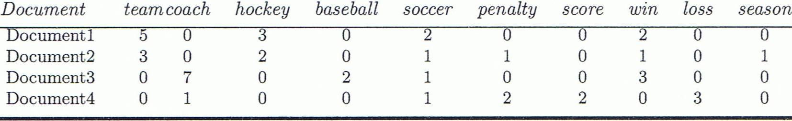
Cosine Similarity of Two Vectors
A document can be represented by a bag of terms or a long vector, with each attribute recording the frequency of a particular term (such as word, keyword, or phrase) in the document
Other vector objects: Gene features in micro-arrays
Applications: Information retrieval, biologic taxonomy, gene feature mapping, etc.
Cosine measure: If d₁ and d₂ are two vectors (e.g., term-frequency vectors), then
    where • indicates vector dot product, ||d||: the length of vector d

Slide 49
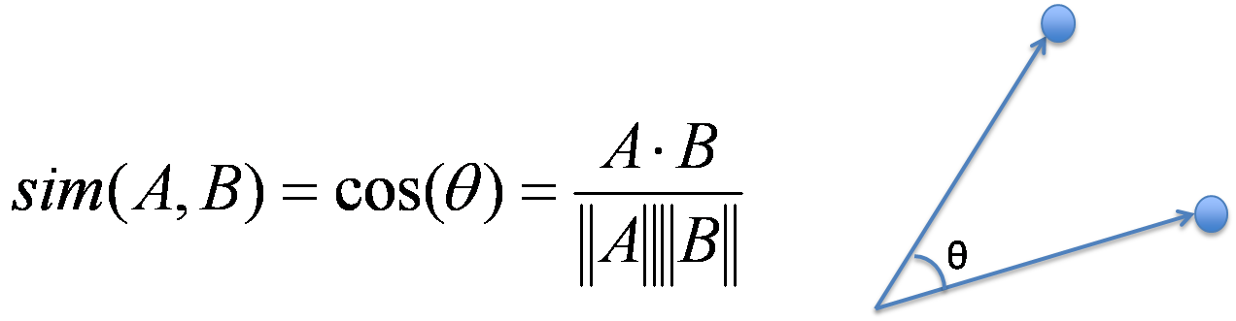
Example: Calculating Cosine Similarity
Calculating Cosine Similarity:
    where • indicates vector dot product, ||d||: the length of vector d
Ex: Find the similarity between documents 1 and 2.
        d₁ = (5, 0, 3, 0, 2, 0, 0, 2, 0, 0) d₂ = (3, 0, 2, 0, 1, 1, 0, 1, 0, 1)
  First, calculate vector dot product
        d₁•d₂ = 5 X 3 + 0 X 0 + 3 X 2 + 0 X 0 + 2 X 1 + 0 X 1 + 0 X 1 + 2 X 1 + 0 X 0 + 0 X 1 = 25
  Then, calculate ||d₁|| and ||d₂||
  Calculate cosine similarity: cos(d₁, d₂ ) = 25/ (6.481 X 4.12) = 0.94

